Slide 1
FLASK. SANIC
Valentyn Malenchak

Slide 2

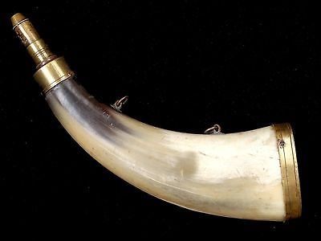
Flask
Flask is a Python MicroFramework for the web.
Micro means simple core, but highly extensible.
Used to create websites and API’s.
Valentyn Malenchak

Slide 3
Why do we use Flask?
is easy to get started;
awesome documentation;
import only you need;
doesn’t force you into any structure;
the least amount of coding as compared to other frameworks.
Valentyn Malenchak
Notes:
https://flask.palletsprojects.com/en/master/

Slide 4
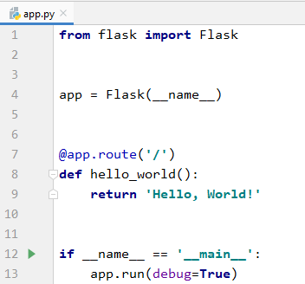
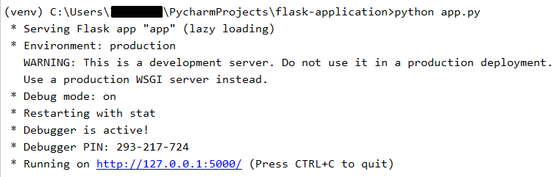
Flask first app
Valentyn Malenchak

Slide 5
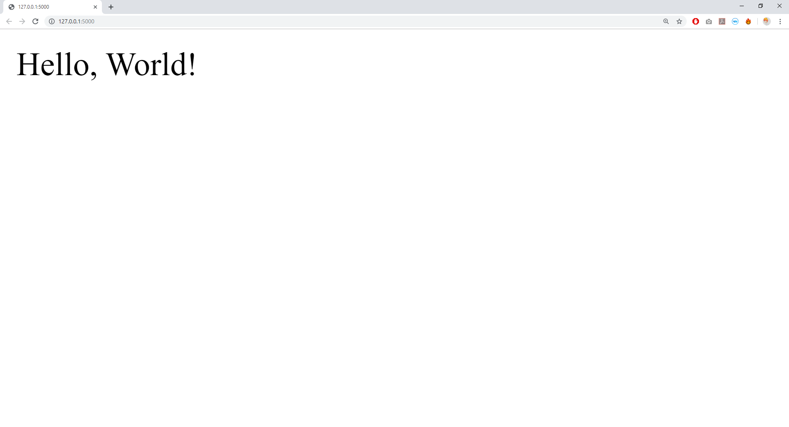
Flask first app
Valentyn Malenchak

Slide 6
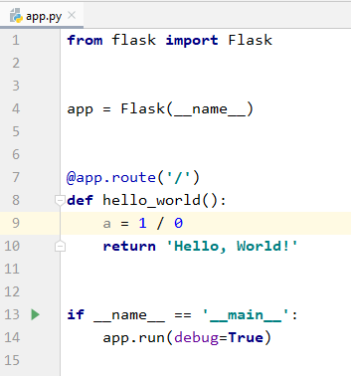
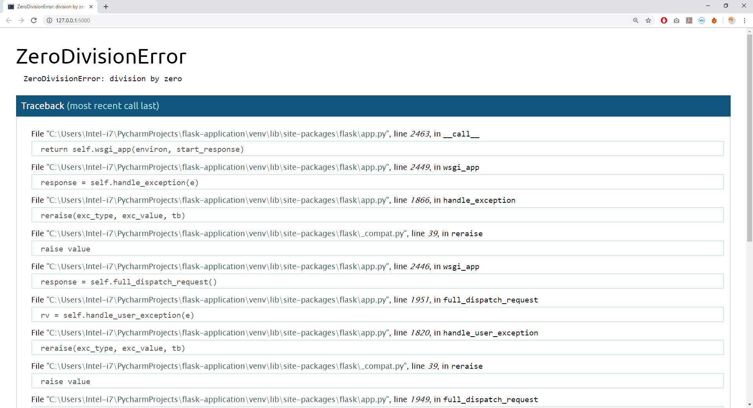
Debug mode
Valentyn Malenchak

Slide 7
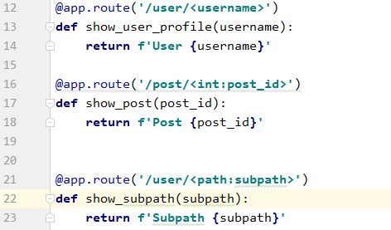
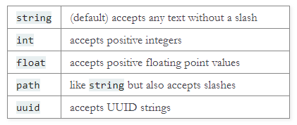
Routing
Valentyn Malenchak

Slide 8
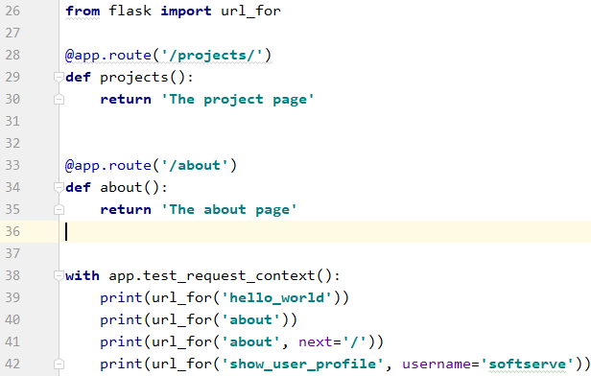
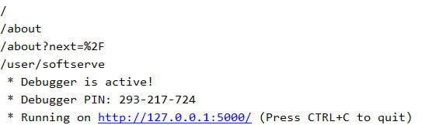
URL Building
Valentyn Malenchak

Slide 9
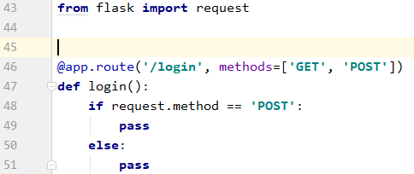
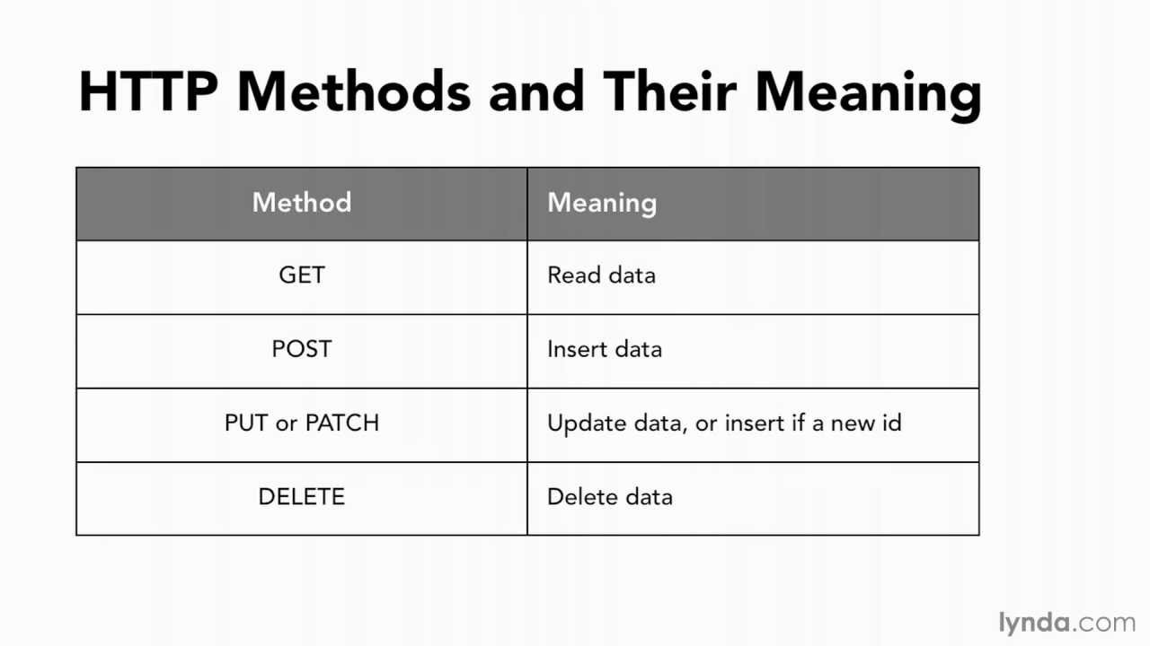
HTTP methods
By default, a route only answers to GET requests.
You can use the methods argument of the route() decorator to handle different HTTP methods.
Valentyn Malenchak

Slide 10
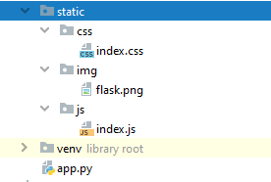
Static files
Create a folder called static in your package or next to your module and it will be available at /static on the application.
To generate URLs for static files, use the special 'static' endpoint name:
url_for('static', filename='css/index.css')
Valentyn Malenchak

Slide 11
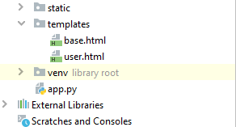
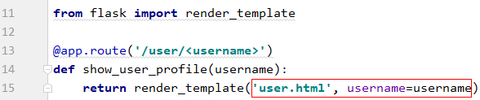
Rendering Templates
To render a template you can use the render_template() method. All you have to do is provide the name of the template and the variables you want to pass to the template engine as keyword arguments.
Valentyn Malenchak

Slide 12
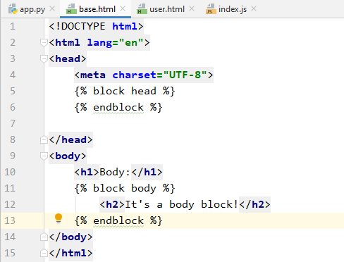
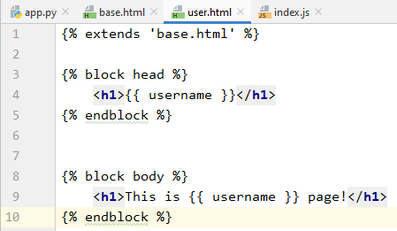
Rendering Templates
Valentyn Malenchak

Slide 13
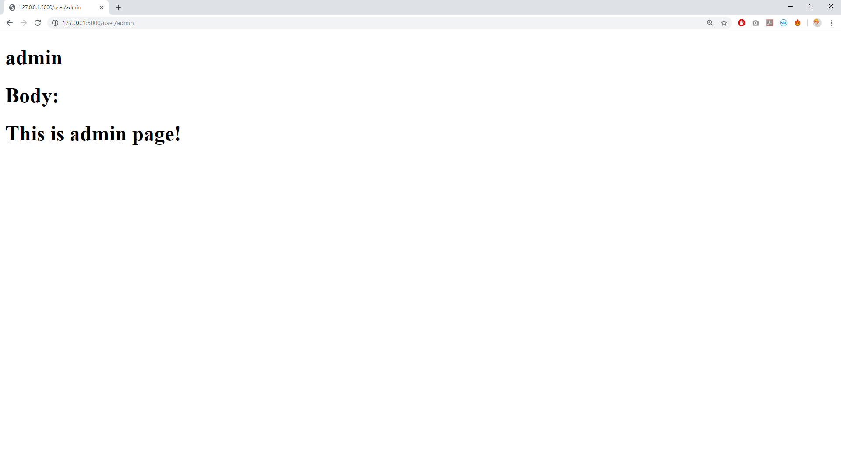
Rendering Templates
Valentyn Malenchak

Slide 14

Sanic
Sanic is a Python 3.6+ web server
and web framework that’s written
to go fast. It allows the usage of the
async/await syntax added in
Python 3.5, which makes your code
non-blocking and speedy.
Valentyn Malenchak
Notes:
https://sanic.readthedocs.io/en/latest/

Slide 15
Why do we use Sanic?
easy to learn;
can be a micro framework up to a full monolith (like Flask);
async capabilities;
great documentation.
Valentyn Malenchak

Slide 16
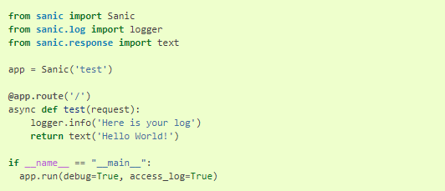
Sanic first app
Valentyn Malenchak

Slide 17
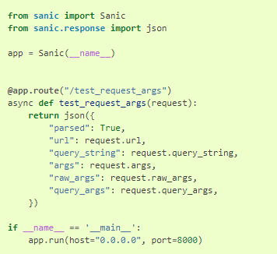
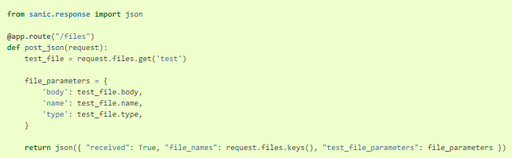

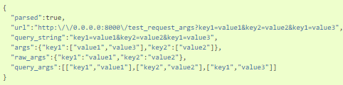

Request Data
Valentyn Malenchak
Notes:
https://sanic.readthedocs.io/en/latest/sanic/request_data.html

Slide 18
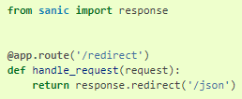
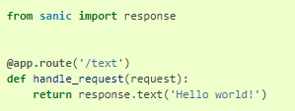
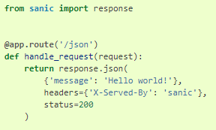
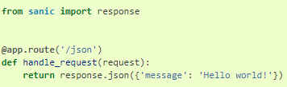
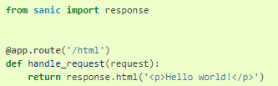
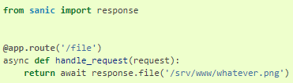
Response
Valentyn Malenchak
Notes:
https://sanic.readthedocs.io/en/latest/sanic/request_data.html

Slide 19
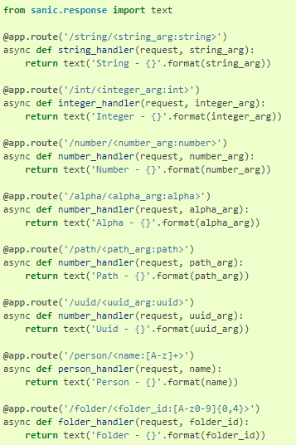
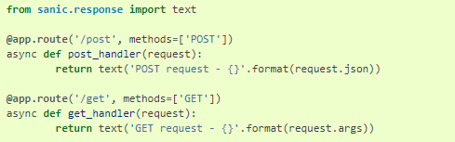
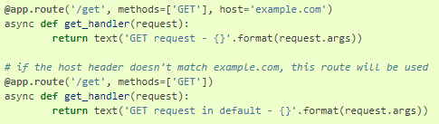
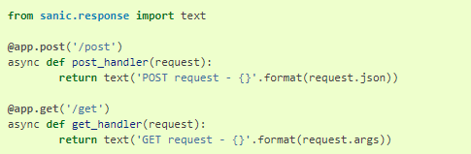
Routing and HTTP request types
Valentyn Malenchak
Notes:
https://sanic.readthedocs.io/en/latest/sanic/request_data.html

Slide 20
Thank you for attention!
|Valentyn Malenchak

